Slide 1


Slide 2


Slide 3

Casey
Mullins
Colonial Pipeline Scenario
What is Ransomware?
The attackers: DarkSide

Slide 4


Colonial Pipeline Scenario
Notes:
Imagine with me you are a recently graduated cyber analyst. this is your third week working for one of the country's most important pieces of energy infrastructure, and just before your night shift duties come to an end at 5 am, an alert shows on your screen. You read the note, you know what this means, you've prepared for this, but you are shaking as you reach for the phone to dial your supervisor. You know the next steps you take will be the most important, because your company has just been hit with a ransomware and the attackers want more than $4 million before they will decrypt your data again. This is the Colonial Pipeline Ransomware Attack'

Slide 5
What is Ransomware?
A type of malicious software designed to block access to a computer system until a sum of money is paid
Or is designed to release sensitive data to the public unless a sum of money is paid.
Uses Asymmetric Encryption
Notes:
'First, let's get you up to speed on what ransomware is' a type of malicious software designed to block access to a computer system until a sum of money is paid or is designed to release sensitive data to the public unless a sum of money is paid. One an attacker has exploited their target, the code injected begins to search for and encrypt the target's files. Ransomware uses asymmetric encryption.
This is cryptography that uses a pair of keys to encrypt and decrypt a file. The public-private pair of keys is uniquely generated by the attacker for the victim, with the private key to decrypt the files stored on the attacker's server. The attacker makes the private key available to the victim only after the ransom is paid, though as seen in recent ransomware campaigns, that is not always the case. Without access to the private key, it is nearly impossible to decrypt the files that are being held for ransom.

Slide 6
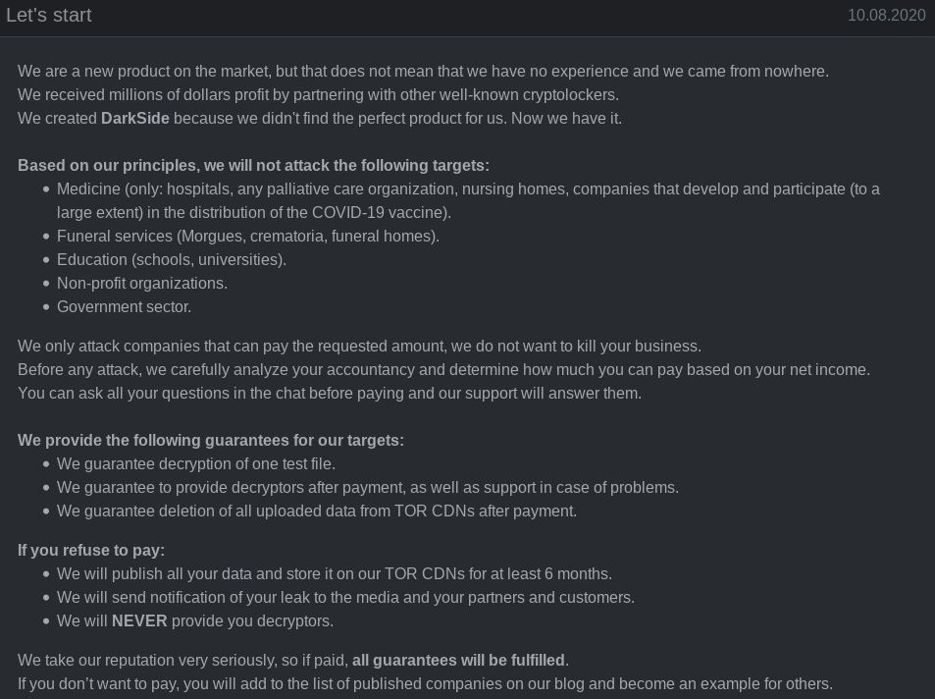
The attackers: DarkSide
Russian Protected, Eastern European Hacking Group
“Robinhood of Hackers”
Hack With ‘Principles’
Possibly Disbanded
Notes:
Darkside is thought to be an Eastern European Hacker collective. Government agencies believe they are based in Russia, protected by the Kremlin.
Darkside considers themselves to be the Robinhood of hacking groups, as you can see from this actual Darkside advertisement, they ‘only attack companies that can pay the requested amount’, and refuse to attack Medicine, funeral services and education centers based on their own ‘Principles’. For now their actual identities remain unknown, but due to recent high profile attacks, such as the Colonial Pipeline, Darkside has announced they are disbanding due to pressure from authorities. Whether they truly have disbanded or not is up is yet to be seen.

Slide 7

Kim
Young
Background
Decisions
Impacts

Slide 8
Background
The Colonial Pipeline is the largest in the US
Darkside is a criminal hacker group, thought to be based in eastern Europe

Slide 9
Decisions
Shutting Down the Pipeline…
the company didn’t know how much access the hackers might gain, maintaining operational control of the pipeline was paramount
to prevent hackers from migrating to the pipeline control system, Colonial decided a complete shutdown was necessary
Paying the Ransom…
wanted to get the pipeline back online as quickly as possible
wanted to keep the situation confidential

Slide 10
Impacts
Panic buying
Inventory reduction
Opportunity cost
Expectation management
Increased regulation and inspection

Slide 11

Rafael Encarnacion
Phishing
RDP Abuse
Vulnerabilities

Slide 12
Phishing
Email Scanning
Sandboxing
Awareness Training
Endpoint Protection

Slide 13
RDP Abuse
Stop Using RDP
See above
Seriously, use something else!
Add MFA

Slide 14
Vulnerabilities
Patching
Vulnerability Scanning/Management
Layered detection for Zero-Day Attacks
Low Privilege

